Slide 1
Message Passing Interface(MPI)
Geetha V
Dept. of Information Technology
NITK Surathkal

Slide 2
Presentation Outline
Programming Paradigms
Distributed architecture
Introduction to MPI
Point to point MPI calls
Sample MPI program
Performance analysis of MPI programs

Slide 3
Programming Paradigms
Sequential
•C, C++, Java
• Multi-core
•OpenMP
•Pthreads
Distributed (listing only for HPC)
•Message Passing Interface (MPI)
•Parallel Virtual Machine (PVM)

Slide 4
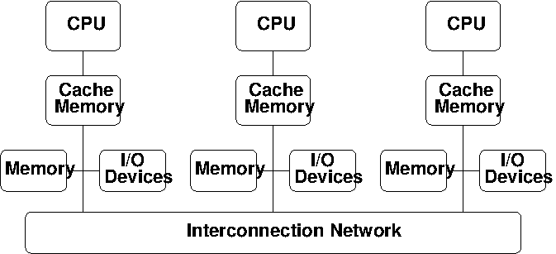
Distributed Parallel Architecture

Slide 5
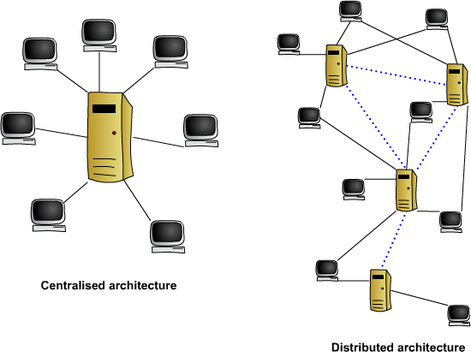
Distributed Architecture

Slide 6
Distributed Architecture
Each node may have many processor cores
High Speed Network
Parallel Programming Libraries
Simplified Operating System

Slide 7
What is MPI?
A message passing library specification
Message passing among processes in parallel computing
Meant for clusters and network of workstations
Message Passing Standard for Parallel Programs
-MPI Implementation left to individual vendors.
-Most commonly supports C, Fortran, C++ programs

Slide 8
Requisites for MPI Implementation
The Following features are needed in MPI Implementations
Allow efficient Communication between processes.
Allow overlap of computation and communication

Slide 9
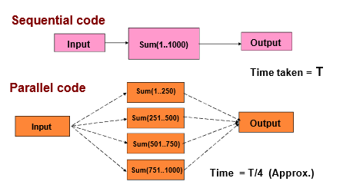
Why Parallelization of Code?

Slide 10
Various MPI Implementation
MPICH(Public Domain)
LAM/MPI: LAM (Local Area Multicomputer) is an MPI programming environment and development system for heterogeneous computers on a network.
SUN MPI: for SUN HPC
IBM MPI: IBM HPC
C-MPI (from C-DAC)

Slide 11
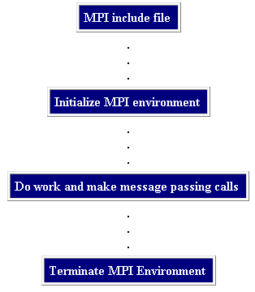
Structure of MPI Program

Slide 12
#include <mpi.h>
#include <stdio.h>
int main(int argc, char** argv) {
MPI_Init(NULL, NULL);
int world_size;
MPI_Comm_size(MPI_COMM_WORLD, &world_size);
int world_rank;
MPI_Comm_rank(MPI_COMM_WORLD, &world_rank);
char processor_name[MPI_MAX_PROCESSOR_NAME];
int name_len;
MPI_Get_processor_name(processor_name, &name_len);
printf("Hello world from processor %s, rank %d"
" out of %d processors\n",
processor_name, world_rank, world_size);
MPI_Finalize();
}

Slide 13
5 Major things to know in MPI
MPI Data types
Format of MPI calls
Communicator
Rank
Communications
Point to point communication
Collective Communication

Slide 14
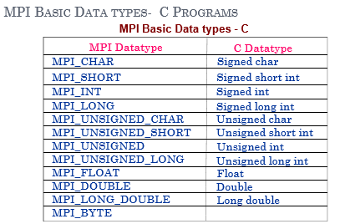
MPI Basic Data Types

Slide 15
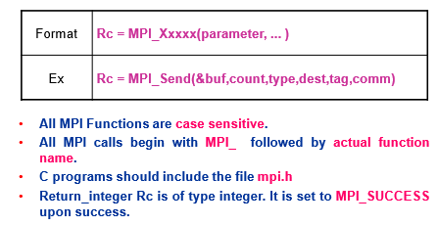
Format of MPI Calls

Slide 16
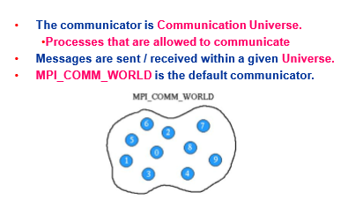
Communicator

Slide 17
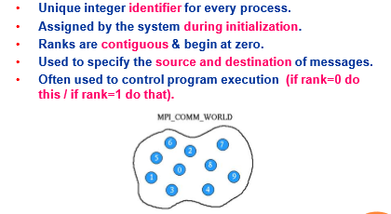
What is Rank in Communicator?

Slide 18
MPI Communications
Point to Point Communications
Blocking
Non Blocking
Collective Communication
Synchronization
Collective Computation
Data Movement

Slide 19
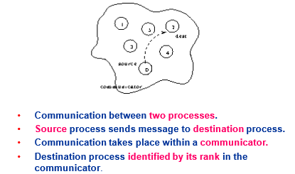
1. MPI point to point communication

Slide 20
MPI_send and MPI_Recv Blocking
MPI_Send:
Basic blocking send operation. Routine returns only after the application buffer in the sending task is free for reuse.
MPI_Recv:
Receive a message and block until the requested data is available in the application buffer in the receiving task

Slide 21
MPI Blocking Send and Recv
Send
Recv
MPI_Send(
void* data,
int count,
MPI_Datatype datatype,
int destination,
int tag,
MPI_Comm communicator)
MPI_Recv(
void* data,
int count,
MPI_Datatype datatype, int source,
int tag,
MPI_Comm communicator, MPI_Status* status)

Slide 22
MPI Blocking Send and Recv
Send
Data Types
MPI_Send(
void* data,
int count,
MPI_Datatype datatype,
int destination,
int tag,
MPI_Comm communicator)

Slide 23
MPI Blocking Send and Recv
Status
Recv
typedef struct _MPI_Status {
int count;
int cancelled;
int MPI_SOURCE;
int MPI_TAG;
int MPI_ERROR;
} MPI_Status, *PMPI_Status;
//To get count of elements
MPI_Status status;
MPI_Get_count(&status, recv_type, &count)
MPI_Recv(
void* data,
int count,
MPI_Datatype datatype, int source,
int tag,
MPI_Comm communicator, MPI_Status* status)

Slide 24
Send and receive message
int tag=200;
if (my_rank !=0){ //slave
sprintf(message, "Hello MPI World from process %d!", my_rank);
dest = 0;
MPI_Send(message, strlen(message)+1, MPI_CHAR, dest, tag, MPI_COMM_WORLD); }
else{ //master
printf("Hello MPI World From process 0: Num processes: %d\n",p);
for (source = 1; source < p; source++) {
MPI_Recv(message, 100, MPI_CHAR, source, tag, MPI_COMM_WORLD, &status);
printf("%s\n",message); }

Slide 25
Send and receive integer value
int tag=200;
if (my_rank !=0){ //slave
sprintf(message, "Hello MPI World from process %d!", my_rank);
dest = 0;
MPI_Recv(&num, 1, MPI_INT, dest, tag, MPI_COMM_WORLD, &status); }
printf("%d\n",num);
else{ //master
num=25;
for (source = 1; source < p; source++) {
MPI_Send(&num, 1, MPI_INT, source, tag, MPI_COMM_WORLD,);
}

Slide 26
Add N Elements
Root
Slave
send count of array elements to each slave
Send array elements to each slave
Find partial sum of elements given to master
Receive partial sum
Calculate total sum
Receive count of elements
Receive elements
Find partial sum of elements given to each slave
Send partial sum to root

Slide 27
MPI Non-Blocking Send and Recv
Send
Recv
int MPI_Isend(
void *buf,
int count,
MPI_Datatype datatype,
int dest,
int tag,
MPI_Comm comm,
MPI_Request *request );
int MPI_Irecv(
void *buf,
int count,
MPI_Datatype datatype,
int source,
int tag,
MPI_Comm comm,
MPI_Request *request)

Slide 28
MPI Non-Blocking Send and Recv
Send
Request
int MPI_Isend(
void *buf,
int count,
MPI_Datatype datatype,
int dest,
int tag,
MPI_Comm comm,
MPI_Request *request );
int MPI_Request_get_status( MPI_Request request,
int *flag,
MPI_Status *status );
request[in] request (handle)
flag[out] true if operation has completed (logical)
status[out] status object (Status).
May be MPI_STATUS_IGNORE.

Slide 29
Non-Blocking Send Recv
#include "mpi.h" #include <stdio.h> int main(int argc, char *argv[]) { int myid, numprocs, left, right; int buffer[10], buffer2[10]; MPI_Request request, request2; MPI_Status status; MPI_Init(&argc,&argv); MPI_Comm_size(MPI_COMM_WORLD, &numprocs); MPI_Comm_rank(MPI_COMM_WORLD, &myid); right = (myid + 1) % numprocs; left = myid - 1; if (left < 0) left = numprocs - 1;
MPI_Irecv(buffer, 10, MPI_INT, left, 123, MPI_COMM_WORLD, &request);
MPI_Isend(buffer2, 10, MPI_INT, right, 123, MPI_COMM_WORLD, &request2); MPI_Wait(&request, &status); MPI_Wait(&request2, &status); MPI_Finalize(); return 0; }

Slide 30
Summary
MPI programming
Blocking and non blocking
Point to point communication

Slide 31
5 Major things to know in MPI
MPI Data types
Format of MPI calls
Communicator
Rank
Communications
Point to point communication
Collective Communication

Slide 32
Overview
Collective communications refer to set of MPI functions that transmit data among all processes specified by a given communicator.
Three general classes
Barrier
Global communication (broadcast, gather, scatter)
Global reduction

Slide 33
Simplifications of collective communications
Collective functions are less flexible than point-to-point in the following ways:
Amount of data sent must exactly match amount of data specified by receiver
No tag argument
Blocking versions only

Slide 34
MPI_Barrier
MPI_Barrier (MPI_Comm comm)
IN : comm (communicator)
Blocks each calling process until all processes in communicator have executed a call to MPI_Barrier.

Slide 35
Examples
Used whenever you need to enforce ordering on the execution of the processors:
e.g. Writing to an output stream in a specified order
Often, blocking calls can implicitly perform the same function as a call to barrier().
Expensive operation

Slide 36
Global Operations
MPI_Bcast, MPI_Gather, MPI_Scatter, MPI_Allreduce, MPI_Alltoall

Slide 37
MPI_Bcast
data
data
A₀
A₀
processes
processes
A₀
broadcast
A₀
A₀
A₀
A₀
A₀ : any chunk of contiguous data described with MPI_Type and count

Slide 38
MPI_Bcast
MPI_Bcast (void *buffer,
int count,
MPI_Datatype type,
int root,
MPI_Comm comm)
INOUT : buffer (starting address, as usual)
IN : count (num entries in buffer)
IN : type (can be user-defined)
IN : root (rank of broadcast root – Sender )
IN : com (communicator)
Broadcasts message from root to all processes (including root).
comm and root must be identical on all processes.
On return, contents of buffer is copied to all processes in comm.

Slide 39
Examples
Read a parameter file on a single processor and send data to all processes.

Slide 40
/* includes here */
int main(int argc, char **argv){
int mype, nprocs;
float data = -1.0;
FILE *file;
MPI_Init(&argc, &argv);
MPI_Comm_size(MPI_COMM_WORLD, &nprocs);
MPI_Comm_rank(MPI_COMM_WORLD, &mype);
if (mype == 0){
char input[100];
file = fopen("data1.txt", "r");
assert (file != NULL);
fscanf(file, "%s\n", input);
data = atof(input);
}
printf("data before: %f\n", data);
MPI_Bcast(&data, 1, MPI_FLOAT, 0, MPI_COMM_WORLD);
printf("data after: %f rank = %d\n", data, mype);
MPI_Finalize();
}

Slide 41
geetha@geetha-OptiPlex-9020:~$ mpirun -np 4 s
data before: 97.000000
data before: -1.000000
data before: -1.000000
data after: 97.000000 rank =2
data before: -1.000000
data after: 97.000000 rank =0
data after: 97.000000 rank =3
data after: 97.000000 rank =1
geetha@geetha-OptiPlex-9020:~$

Slide 42
MPI_Scatter MPI_Gather
data
data
A₀
A₁
A₂
A₃
A₄
A₅
A₀
processes
Scatter
processes
A₁
Gather
A₂
A₃
A₄
A₅

Slide 43
MPI_Gather
MPI_Gather (void *sendbuf,
int sendcount,
MPI_Datatype sendtype,
void *recvbuf,
int recvcount,
MPI_Datatype recvtype,
int root,
MPI_Comm comm)
IN sendbuf (starting address of send buffer)
IN sendcount (number of elements in send buffer)
IN sendtype (type)
OUT recvbuf (address of receive buffer)
IN recvcount (n-elements for any single receive)
IN recvtype (data type of recv buffer elements)
IN root (rank of receiving process)
IN comm (communicator)

Slide 44
MPI_Gather
Each process sends content of send buffer to the root process.
Root receives and stores in rank order.
Note: Receive buffer argument ignored for all non-root processes (also recvtype, etc.)
Also, note that recvcount on root indicates number of items received from each process, not total. This is a very common error.
Exercise: Sketch an implementation of MPI_Gather using only send and receive operations.

Slide 45
int main(int argc, char **argv){
int mype, nprocs, nl=2, n, i, j;
float *data, *data_l
MPI_Init(&argc, &argv);
MPI_Comm_size(MPI_COMM_WORLD, &nprocs);
MPI_Comm_rank(MPI_COMM_WORLD, &mype);
/* local array size on each proc = nl */
data_l = (float *) malloc(nl*sizeof(float));
for (i = 0; i < nl; ++i) data_l[i] = mype;
if (mype == 0) data = (float *) malloc(nprocs*sizeof(float)*nl);
MPI_Gather(data_l, nl, MPI_FLOAT, data, nl,
MPI_FLOAT, 0,MPI_COMM_WORLD);
if (mype == 0){
for (i = 0; i < nl*nprocs; ++i){
printf("%f ", data[i]);
}
}
MPI_Finalize();}

Slide 46
geetha@geetha-OptiPlex-9020:~$ mpirun -np 4 s
rank 0 data 0.000000
rank 0 data 0.000000
rank 0 data 1.000000
rank 0 data 1.000000
rank 0 data 2.000000
rank 0 data 2.000000
rank 0 data 3.000000
rank 0 data 3.000000

Slide 47
MPI_Scatter
MPI_Scatter (void *sendbuf,
int sendcount,
MPI_Datatype sendtype,
void *recvbuf,
int recvcount,
MPI_Datatype recvtype,
int root,
MPI_Comm comm)
IN sendbuf (starting address of send buffer)
IN sendcount (number of elements sent to each process)
IN sendtype (type)
OUT recvbuf (address of receive bufer)
IN recvcount (n-elements in receive buffer)
IN recvtype (data type of receive elements)
IN root (rank of sending process)
IN comm (communicator)

Slide 48
MPI_Scatter
Inverse of MPI_Gather
Data elements on root listed in rank order – each processor gets corresponding data chunk after call to scatter.
Note: all arguments are significant on root, while on other processes only recvbuf, recvcount, recvtype, root, and comm are significant.

Slide 49
Examples
Scatter: automatically create a distributed array from a serial one.
Gather: automatically create a serial array from a distributed one.

Slide 50
int main(int argc, char **argv){
int mype, nprocs, nl=2, n, j;
float *data, *data_l;
MPI_Init(&argc, &argv);
MPI_Comm_size(MPI_COMM_WORLD, &nprocs);
MPI_Comm_rank(MPI_COMM_WORLD, &mype);
/* local array size on each proc = nl */
data_l = (float *) malloc(nl*sizeof(float));
if (mype == 0){
int i;
data = (float *) malloc(nprocs*sizeof(float)*nl);
for (i = 0; i < nprocs*nl; ++i) data[i] = i;}
MPI_Scatter(data, nl, MPI_FLOAT, data_l, nl, MPI_FLOAT, 0, MPI_COMM_WORLD);
for (n = 0; n < nprocs; ++n){
if (mype == n){
for (j = 0; j < nl; ++j) printf("%f ", data_l[j]);
}
MPI_Barrier(MPI_COMM_WORLD);
}

Slide 51
geetha@geetha-OptiPlex-9020:~$ mpirun -np 4 s
0.000000 1.000000 2.000000 3.000000 6.000000 7.000000 4.000000 5.000000

Slide 52
MPI_Allgather
data
data
A₀
A₀
B₀
C₀
D₀
E₀
F₀
processes
processes
B₀
A₀
B₀
C₀
D₀
E₀
F₀
C₀
allgather
A₀
B₀
C₀
D₀
E₀
F₀
D₀
A₀
B₀
C₀
D₀
E₀
F₀
E₀
A₀
B₀
C₀
D₀
E₀
F₀
F₀
A₀
B₀
A₀
D₀
E₀
F₀

Slide 53
MPI_Allgather
MPI_Allgather (void *sendbuf,
int sendcount,
MPI_Datatype sendtype,
void *recvbuf,
int recvcount,
MPI_Datatype recvtype,
MPI_Comm comm)
IN sendbuf (starting address of send buffer)
IN sendcount (number of elements in send buffer)
IN sendtype (type)
OUT recvbuf (address of receive bufer)
IN recvcount (n-elements received from any proc)
IN recvtype (data type of receive elements)
IN comm (communicator)

Slide 54
MPI_Allgather
Each process has some chunk of data. Collect in a rank-order array on a single proc and broadcast this out to all procs.
Like MPI_Gather except that all processes receive the result (instead of just root).
Exercise: How can MPI_Allgather be cast interms of calls to MPI_Gather?

Slide 55
int main(int argc, char **argv){
int mype, nprocs, nl=2, n, i, j;
float *data, *data_l;
MPI_Init(&argc, &argv);
MPI_Comm_size(MPI_COMM_WORLD, &nprocs);
MPI_Comm_rank(MPI_COMM_WORLD, &mype);
/* local array size on each proc = nl */
data_l = (float *) malloc(nl*sizeof(float));
for (i = 0; i < nl; ++i) data_l[i] = mype;
data = (float *) malloc(nprocs*sizeof(float)*nl);
MPI_Allgather(data_l, nl, MPI_FLOAT, data, nl, MPI_FLOAT, MPI_COMM_WORLD);
for (i = 0; i < nl*nprocs; ++i) printf("%f ", data[i]);
MPI_Finalize();
}

Slide 56
MPI_Alltoall similar to all gather
data
data
A₀
A₁
A₂
A₃
A₄
A₅
A₀
B₀
C₀
D₀
E₀
F₀
processes
processes
B₀
B₁
B₂
B₃
B₄
B₅
A₁
B₁
C₁
D₁
E₁
F₁
C₀
C₁
C₂
C₃
C₄
C₅
alltoall
A₂
B₂
C₂
D₂
E₂
F₂
D₀
D₁
D₂
D₃
D₄
D₅
A₃
B₃
C₃
D₃
E₃
F₃
E₀
E₁
E₂
E₃
E₄
E₅
A₄
B₄
C₄
D₄
E₄
F₄
F₀
F₁
F₂
F₃
F₄
F₅
A₅
B₅
A₅
D₅
E₅
F₅

Slide 57
MPI_Alltoall
MPI_Alltoall (void *sendbuf,
int sendcount,
MPI_Datatype sendtype,
void *recvbuf,
int recvcount,
MPI_Datatype recvtype,
MPI_Comm comm)
IN sendbuf (starting address of send buffer)
IN sendcount (number of elements sent to each proc)
IN sendtype (type)
OUT recvbuf (address of receive bufer)
IN recvcount (n-elements in receive buffer)
IN recvtype (data type of receive elements)
IN comm (communicator)

Slide 58
MPI_Alltoall
MPI_Alltoall is an extension of MPI_Allgather to case where each process sends distinct data to each reciever
Exercise: express using just MPI_Send and MPI_recv

Slide 59
int main(int argc, char **argv){
int mype, nprocs, nl=2, n, i, j;
float *data, *data_l
MPI_Init(&argc, &argv);
MPI_Comm_size(MPI_COMM_WORLD, &nprocs);
MPI_Comm_rank(MPI_COMM_WORLD, &mype);
/* local array size on each proc = nl */
data_l = (float *) malloc(nl*sizeof(float)*nprocs);
for (i = 0; i < nl*nprocs; ++i) data_l[i] = mype;
data = (float *) malloc(nprocs*sizeof(float)*nl);
MPI_Alltoall(data_l, nl, MPI_FLOAT, data, nl,
MPI_FLOAT, MPI_COMM_WORLD);
for (i = 0; i < nl*nprocs; ++i) printf("%f ", data[i]);
MPI_Finalize();
}

Slide 60
Vector variants
Previous functions have vector version that allows for manipulation of different size chunks of data on different processors
These are:
MPI_Gatherv, MPI_Scatterv, MPI_Allgatherv, MPI_Alltoallv
Each has two extra integer array arguments – recvcounts and displacements – that specify size of data chunk on i’th process and where it will be stored on root

Slide 61
MPI_Gatherv
MPI_Gatherv (void *sendbuf, int sendcount, MPI_Datatype sendtype, void *recvbuf, int *recvcounts, int *displs, MPI_Datatype recvtype, int root, MPI_Comm comm)
IN sendbuf (starting address of send buffer)
IN sendcount (number of elements)
IN sendtype (type)
OUT recvbuf (address of receive bufer)
IN recvcounts (integer array of chunksize on proc i)
IN displs (integer array of displacements)
IN recvtype (data type of recv buffer elements)
IN root (rank of receiving process)
IN comm (communicator)

Slide 62
MPI_Scatterv
MPI_Scatterv (void *sendbuf, int *sendcounts, int *displs, MPI_Datatype sendtype, void *recvbuf, int recvcount, MPI_Datatype recvtype, int root, MPI_Comm comm)
IN sendbuf (starting address of send buffer)
IN sendcounts (integer array #elements)
IN displs (integer array of displacements)
IN sendtype (type)
OUT recvbuf (address of receive bufer)
IN recvcount (number of elements in receive buffer)
IN recvtype (data type of receive buffer elements)
IN root (rank of receiving process)
IN comm (communicator)

Slide 63
MPI_Allgatherv
MPI_Allgatherv (void *sendbuf, int sendcount, MPI_Datatype sendtype, void *recvbuf, int *recvcounts, int *displs, MPI_Datatype recvtype, MPI_Comm comm)
IN sendbuf (starting address of send buffer)
IN sendcount (number of elements)
IN sendtype (type)
OUT recvbuf (address of receive bufer)
IN recvcounts (integer arrays – see notes)
IN displs (integer array of displacements)
IN recvtype (data type of receive elements)
IN comm (communicator)

Slide 64
MPI_Alltoallv
MPI_Alltoallv (void *sendbuf, int *sendcounts, int *sdispls, MPI_Datatype sendtype, void *recvbuf, int *recvcounts, int *rdispls, MPI_Datatype recvtype, MPI_Comm comm);
IN sendbuf (starting address of send buffer)
IN sendcounts (number of elements)
IN sdispls
IN sendtype (type)
OUT recvbuf (address of receive bufer)
IN recvcounts (n-elements in receive buffer)
IN recvdispls
IN recvtype (data type of receive elements)
IN comm (communicator)

Slide 65
Global Reduction Operations

Slide 66
Reduce/Allreduce
A0 | B0 | C0
A1 | B1 | C1
A2 | B2 | C2
A0+A1+A2 | B0+B1+B2 | C0+C1+C2
reduce
A0 | B0 | C0
A1 | B1 | C1
A2 | B2 | C2
A0+A1+A2 | B0+B1+B2 | C0+C1+C2
A0+A1+A2 | B0+B1+B2 | C0+C1+C2
A0+A1+A2 | B0+B1+B2 | C0+C1+C2
allreduce

Slide 67
Reduce_scatter/Scan
A0 | B0 | C0
A1 | B1 | C1
A2 | B2 | C2
A0+A1+A2
B0+B1+B2
C0+C1+C2
reduce-scatter
A0 | B0 | C0
A1 | B1 | C1
A2 | B2 | C2
A0 | B0 | C0
A0+A1 | B0+B1 | C0+C1
A0+A1+A2 | B0+B1+B2 | C0+C1+C2
scan

Slide 68
MPI_Reduce
MPI_Reduce (void *sendbuf,
void *recvbuf,
int count,
MPI_Datatype datatype,
MPI_Op op,
int root,
MPI_Comm comm)
IN sendbuf (address of send buffer)
OUT recvbuf (address of receive buffer)
IN count (number of elements in send buffer)
IN datatype (data type of elements in send buffer)
IN op (reduce operation)
IN root (rank of root process)
IN comm (communicator)

Slide 69
MPI_Reduce
MPI_Reduce combines elements specified by send buffer and performs a reduction operation on them.
There are a number of predefined reduction operations: MPI_MAX, MPI_MIN, MPI_SUM, MPI_LAND, MPI_BAND, MPI_LOR, MPI_BOR, MPI_LXOR, MPI_BXOR, MPI_MAXLOC, MPI_MINLOC

Slide 70
int main(int argc, char **argv){
int mype, nprocs, gsum, gmax, gmin, data_l;
MPI_Init(&argc, &argv);
MPI_Comm_size(MPI_COMM_WORLD, &nprocs);
MPI_Comm_rank(MPI_COMM_WORLD, &mype);
data_l = mype;
MPI_Reduce(&data_l, &gsum, 1, MPI_INT, MPI_SUM, 0, MPI_COMM_WORLD);
MPI_Reduce(&data_l, &gmax, 1, MPI_INT, MPI_MAX, 0, MPI_COMM_WORLD);
MPI_Reduce(&data_l, &gmin, 1, MPI_INT, MPI_MIN, 0, MPI_COMM_WORLD);
if (mype == 0) printf("gsum: %d, gmax: %d gmin:%d\n", gsum,gmax,gmin);
MPI_Finalize();
}

Slide 71
MPI_Allreduce
MPI_Allreduce (void *sendbuf,
void *recvbuf,
int count,
MPI_Datatype datatype,
MPI_Op op,
MPI_Comm comm)
IN sendbuf (address of send buffer)
OUT recvbuf (address of receive buffer)
IN count (number of elements in send buffer)
IN datatype (data type of elements in send buffer)
IN op (reduce operation)
IN comm (communicator)

Slide 72
int main(int argc, char **argv){
int mype, nprocs, gsum, gmax, gmin, data_l;
MPI_Init(&argc, &argv);
MPI_Comm_size(MPI_COMM_WORLD, &nprocs);
MPI_Comm_rank(MPI_COMM_WORLD, &mype);
data_l = mype;
MPI_Allreduce(&data_l, &gsum, 1, MPI_INT, MPI_SUM, MPI_COMM_WORLD);
MPI_Allreduce(&data_l, &gmax, 1, MPI_INT, MPI_MAX, MPI_COMM_WORLD);
MPI_Allreduce(&data_l, &gmin, 1, MPI_INT, MPI_MIN, MPI_COMM_WORLD);
printf("gsum: %d, gmax: %d gmin:%d\n", gsum,gmax,gmin);
MPI_Finalize();
}

Slide 73
MPI_Reduce_scatter
MPI_Reduce_scatter (void *sendbuf,
void *recvbuf,
int *recvcount,
MPI_Datatype datatype,
MPI_Op op,
MPI_Comm comm)
IN sendbuf (address of send buffer)
OUT recvbuf (address of receive buffer)
IN recvcounts (integer array)
IN datatype (data type of elements in send buffer)
IN op (reduce operation)
IN comm (communicator)

Slide 74
int main(int argc, char **argv){
int mype, nprocs, i, int gsum;
int *data_l, *recvcounts;
MPI_Init(&argc, &argv);
MPI_Comm_size(MPI_COMM_WORLD, &nprocs);
MPI_Comm_rank(MPI_COMM_WORLD, &mype);
data_l = (int *) malloc(nprocs*sizeof(int));
for (i = 0; i < nprocs; ++i) data_l[i] = mype;
recvcounts = (int *) malloc(nprocs*sizeof(int));
for (i = 0; i < nprocs; ++i) recvcounts[i] = 1;
MPI_Reduce_scatter(data_l, &gsum, recvcounts, MPI_INT,
MPI_SUM, MPI_COMM_WORLD);
printf("gsum: %d\n", gsum);
MPI_Finalize();
}

Slide 75
MPI_Scan
MPI_Scan (void *sendbuf,
void *recvbuf,
int count,
MPI_Datatype datatype,
MPI_Op op,
MPI_Comm comm)
IN sendbuf (address of send buffer)
OUT recvbuf (address of receive buffer)
IN count (number of elements in send buffer)
IN datatype (data type of elements in send buffer)
IN op (reduce operation)
IN comm (communicator)
Note: count refers to total number of elements that will be received into receive buffer after operation is complete

Slide 76
int main(int argc, char **argv){
int mype, nprocs,i, n;
int *result, *data_l;
MPI_Init(&argc, &argv);
MPI_Comm_size(MPI_COMM_WORLD, &nprocs);
MPI_Comm_rank(MPI_COMM_WORLD, &mype);
data_l = (int *) malloc(nprocs*sizeof(int));
for (i = 0; i < nprocs; ++i) data_l[i] = mype;
result = (int *) malloc(nprocs*sizeof(int));
MPI_Scan(data_l, result, nprocs, MPI_INT,
MPI_SUM, MPI_COMM_WORLD);
for (n = 0; n < nprocs; ++n){
if (mype == n)
for (i = 0; i < nprocs; ++i)
printf("gsum: %d\n", result[i]);
MPI_Barrier(MPI_COMM_WORLD);
}
MPI_Finalize();
}

Slide 77
MPI_Exscan
MPI_Exscan (void *sendbuf,
void *recvbuf,
int count,
MPI_Datatype datatype,
MPI_Op op,
MPI_Comm comm)
IN sendbuf (address of send buffer)
OUT recvbuf (address of receive buffer)
IN count (number of elements in send buffer)
IN datatype (data type of elements in send buffer)
IN op (reduce operation)
IN comm (communicator)

Slide 78
int main(int argc, char **argv){
int mype, nprocs,i, n;
int *result, *data_l;
MPI_Init(&argc, &argv);
MPI_Comm_size(MPI_COMM_WORLD, &nprocs);
MPI_Comm_rank(MPI_COMM_WORLD, &mype);
data_l = (int *) malloc(nprocs*sizeof(int));
for (i = 0; i < nprocs; ++i) data_l[i] = mype;
result = (int *) malloc(nprocs*sizeof(int));
MPI_Exscan(data_l, result, nprocs, MPI_INT,
MPI_SUM, MPI_COMM_WORLD);
for (n = 0; n < nprocs; ++n){
if (mype == n)
for (i = 0; i < nprocs; ++i)
printf("gsum: %d\n", result[i]);
MPI_Barrier(MPI_COMM_WORLD);
}
MPI_Finalize();
}

Slide 79
Summary
MPI programming
Blocking and non blocking
Point to point communication
Collective Communication

